Slide 1

SOAP and REST Web Services - Theory
www.pragmatic.bg
Lector: Dimitar Topuzov
E-mail: dtopuzov@gmail.com
LinkedIn: http://bg.linkedin.com/pub/dimitar-topuzov/18/470/833/en
Copyright © Pragmatic LLC 2015

Slide 2
Content
Different Types of Web Services
SOAP Services – Theory
SOAP (Simple Object Access Protocol)
WSDL (Web Service Description Language)
UDDI (Universal Description Discovery and Integration)
RESTful Services – Theory
Resource
Representation
Actions
SOAP vs. REST

Slide 3

Web Service Types
Person A
Person B
Hi, how are you?
Fine.
Two important things
Media / Transport (Phone)
Message Format (English grammar)

Slide 4
Web Service Types
Based on messaging format and transport we can distinguish two types of Web Services
SOAP
REST

Slide 5
SOAP Services
Message Format
XML
SOAP strictly defines message format in SOAP protocol
Transport
HTTP, FTP, UDP

Slide 6
REST Services
Message Format
XML, JSON, YAML, HTML, plain text
Message can be anything we can transfer over the network
Data is send as it is (not enveloped)
Transport
HTTP

Slide 7
What is SOAP?
SOAP Services are based on SOAP protocol
SOAP stands for Simple Object Access Protocol
SOAP is
A communication protocol
A format for sending messages
Based on XML
Platform independent
Language independent
Simple and extensible
Will be developed as a W3C standard

Slide 8
SOAP Services
In order to access the server client should know two things
Location of the service (where the service is)
Description of the service (what this service provides and how it works)
Description is XML file know as WSDL
WSDL stands for “Web Services Description Language”

Slide 9
SOAP Services
How client locate the server
Server knows the client and send him WSDL
UDDI
Place where service providers register their services
UDDI stands for “Universal Description, Discovery and Integration”

Slide 10
SOAP Services
UDDI communication workflow
Client search UDDI
UDDI returns all services providing searched service
Client choses a service and get its WSDL

Slide 11
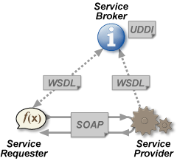
SOAP Services
SOAP Services communication in picture

Slide 12
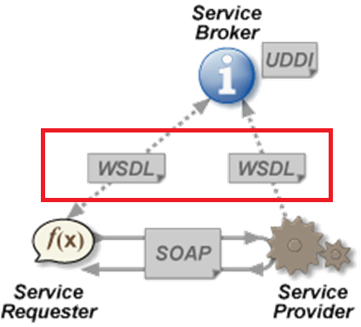
What is WSDL?
WSDL is an XML-based language
WSDL document is actually XML document
WSDL is used to describe Web services
WSDL is also used to locate Web services
WSDL is W3C recommendation

Slide 13
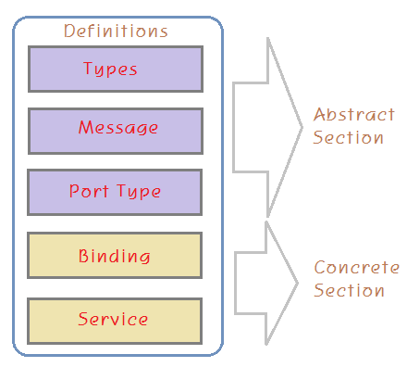
WSDL Structure
Abstract Section
What messages service use
What operations service can perform
Concrete Section
Where service is located
How we can access the service

Slide 14
WSDL Abstract Section
Types
Defines the data type definitions for messages that will be exchanged by the web service.
Message
Defines the set of actual messages that will be exchanged.
PortType
Defines the operations provided/available and involved messages.
Operation refers to the messages involved in the transaction.

Slide 15
WSDL Concrete Section
Bindings
Defines transport protocol
Defines the message format for operations defined by the portType.
Service
Defines the endpoint where the web service will be exposed

Slide 16
WSDL Example
Examples
Example 1
Example 2

Slide 17
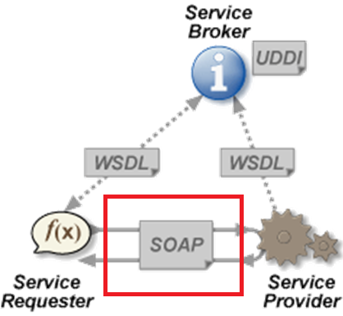
SOAP Messages
Client and server communicate with SOAP messages

Slide 18
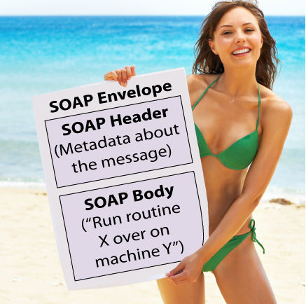
SOAP Messages
Plain SOAP Message Diagram

Slide 19
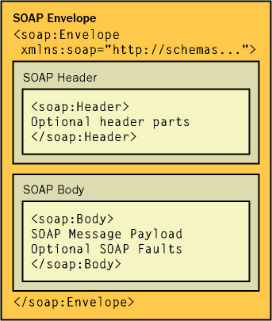
SOAP Messages
SOAP Message contains following main elements:
Envelope (mandatory)
Header (optional)
Body (mandatory)
Both SOAP Requests and Responses use Envelope

Slide 20
SOAP Message
<soap:Envelope
xmlns:soap=”http://www.w3.org/2001/12/soap-envelope”
soap:encodingStyle=”http://www.w3.org/2001/12/soap-encoding”>
<soap:Header>
[Here’s where extraneous information, like password data, resides]
</soap:Header>
<soap:Body>
[Here’s where the actual message content resides]
<soap:Fault>
[Here are instructions to the server about how to handle errors]
</soap:Fault>
</soap:Body>
</soap:Envelope>
Notes:
The SOAP Fault element holds errors and status information for a SOAP message.
The SOAP Fault Element
The optional SOAP Fault element is used to indicate error messages.
If a Fault element is present, it must appear as a child element of the Body element. A Fault element can only appear once in a SOAP message.
The SOAP Fault element has the following sub elements:

Slide 21
SOAP Envelope
SOAP Envelope encapsulates the entire message
SOAP Envelope is the root element of a SOAP message
This element defines the XML document as a SOAP message.
SOAP Envelope contains two child elements, an optional <Header> and a mandatory <Body>

Slide 22
SOAP Header
SOAP Header is optional
Must be the first child element of the Envelope
Header elements can occur multiple times
Header includes information that might be needed by the receiver but isn’t strictly part of the message content, like
login and password information
digital signatures
maximum time the SOAP request may take to process
state

Slide 23
SOAP Header Attributes
Attributes that appear in a SOAPHeaderElement object
Attributes appear in Header elements
Determine how a recipient processes a message
The SOAP 1.1 specification defines two attributes that can appear in SOAP Header Element:
actor
mustUnderstand
The SOAP 1.2 specification defines three attributes:
role (a new name for actor)
mustUnderstand
relay

Slide 24
Role/Actor Attribute
Attributes that appear in a SOAPHeaderElement object
Header blocks (elements) can be targeted at nodes acting in specific roles
If a header block is targeted for nodes acting in the "ultimateReceiver" role, then only nodes acting as ultimate receivers must process that header block. All other nodes should leave it unprocessed.

Slide 25
mustUnderstand Attribute
Indicate whether a header entry is mandatory or optional
Has two valid values
True
Means that any node (computer) processing the SOAP message must understand the given header block
If intermediate node does not understand the header block (element) containing the mustUnderstand attribute, it must return a SOAP fault.
False
Means that node might not understand given header block

Slide 26
Relay Attribute
Determines if a header block is allowed to be relayed if not processed
Has two valid values
True
Header element can be forwarded even if not processed
False (Default)
Header element should be removed if the message is forwarded

Slide 27
SOAP Body
The SOAP Body element is mandatory
The SOAP Body element contains the actual SOAP message
Sample request:
<soap:Body> <m:GetPrice xmlns:m="http://www.w3schools.com/prices"> <m:Item>Apples</m:Item> </m:GetPrice> </soap:Body>
Sample response:
<soap:Body> <m:GetPriceResponse xmlns:m="http://www.w3schools.com/prices"> <m:Price>1.90</m:Price> </m:GetPriceResponse> </soap:Body>
Notes:
The SOAP Body element contains the actual SOAP message.
The SOAP Body Element
The required SOAP Body element contains the actual SOAP message intended for the ultimate endpoint of the message.
Immediate child elements of the SOAP Body element may be namespace-qualified.

Slide 28
SOAP Fault
SOAP Fault element is optional
Must appear as a child element of the Body element
Fault element can only appear once in a SOAP
Holds errors and status information for a SOAP message
Notes:
The SOAP Fault element holds errors and status information for a SOAP message.
The SOAP Fault Element
The optional SOAP Fault element is used to indicate error messages.
If a Fault element is present, it must appear as a child element of the Body element. A Fault element can only appear once in a SOAP message.
The SOAP Fault element has the following sub elements:

Slide 29
SOAP Fault
SOAP Fault element has the following sub elements
<faultcode>
A code for identifying the fault
<faultstring>
A human readable explanation of the fault
<faultactor>
Information about who caused the fault to happen
<detail>
Holds application specific error information related to the Body element
Notes:
The SOAP Fault element holds errors and status information for a SOAP message.
The SOAP Fault Element
The optional SOAP Fault element is used to indicate error messages.
If a Fault element is present, it must appear as a child element of the Body element. A Fault element can only appear once in a SOAP message.
The SOAP Fault element has the following sub elements:

Slide 30
SOAP Faultcode Values
SOAP Fault code values
<VersionMismatch>
Found an invalid namespace for the SOAP Envelope element
<MustUnderstand>
Child element of the Header element, with the mustUnderstand attribute set to "1", was not understood
<Client>
The message was incorrectly formed or contained incorrect information
<Server>
There was a problem with the server so the message could not proceed
Notes:
The SOAP Fault element holds errors and status information for a SOAP message.
The SOAP Fault Element
The optional SOAP Fault element is used to indicate error messages.
If a Fault element is present, it must appear as a child element of the Body element. A Fault element can only appear once in a SOAP message.
The SOAP Fault element has the following sub elements:

Slide 31
SOAP Example
Examples
Example Request
Example Response

Slide 32
What is REST?
REST stands for “Representational State Transfer”
Definition
Representational State Transfer (REST) is a software architecture style consisting of guidelines and best practices for creating scalable web services.
REST is not a standard!
Notes:
REST stands for Representational State Transfer. (It is sometimes spelled "ReST".) It relies on a stateless, client-server, cacheable communications protocol -- and in virtually all cases, the HTTP protocol is used.
REST is an architecture style for designing networked applications. The idea is that, rather than using complex mechanisms such as CORBA, RPC or SOAP to connect between machines, simple HTTP is used to make calls between machines.
In many ways, the World Wide Web itself, based on HTTP, can be viewed as a REST-based architecture.
RESTful applications use HTTP requests to post data (create and/or update), read data (e.g., make queries), and delete data. Thus, REST uses HTTP for all four CRUD (Create/Read/Update/Delete) operations.
REST is a lightweight alternative to mechanisms like RPC (Remote Procedure Calls) and Web Services (SOAP, WSDL, et al.). Later, we will see how much more simple REST is.
Despite being simple, REST is fully-featured; there's basically nothing you can do in Web Services that can't be done with a RESTful architecture.
REST is not a "standard". There will never be a W3C recommendataion for REST, for example. And while there are REST programming frameworks, working with REST is so simple that you can often "roll your own" with standard library features in languages like Perl, Java, or C#.

Slide 33
REST Concepts
A RESTful system should be
Client-server
Stateless
Each request should be independent of others
Cacheable
Clients are able to cache responses
Responses must therefore, implicitly or explicitly, define themselves as cacheable, or not
Uniformly accessible
Each resource must have a unique address and a valid point of access

Slide 34
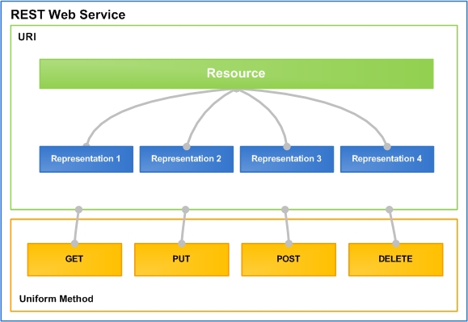
A RESTful System Main Actors
Resources, Representations and Actions

Slide 35
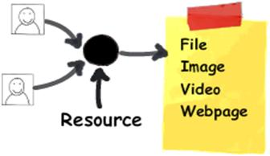
Resources
A resources is "everything" the service can provide
State and functions of a remote application are also considered as resources
A resource must have a unique address over the Web
Example of resources:
Title of a movie from IMDb
YouTube video
Images from Flicker
Order info from eBay

Slide 36
Representations
The representations of resources is what is sent back and forth clients and servers
We never send or receive resources, only their representations

Slide 37
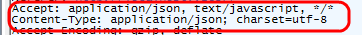
Representation Formats
Different clients are able to consume different representations of the same resource
A representation can take various forms, but its resource has to be available through the same URI
The format of the representations is determined by the content-type
Content type is a reusable collection of settings that you want to apply to a certain category of content

Slide 38
XML Format
XML is markup-language for encoding documents in machine-readable form
Text-based format
Consists of tags, attributes and content
Provide data and meta-data in the same time
<?xml version="1.0"?>
<library>
<book><title>HTML 5</title><author>Bay Ivan</author></book>
<book><title>WPF 4</title><author>Microsoft</author></book>
<book><title>WCF 4</title><author>Kaka Mara</author></book>
<book><title>UML 2.0</title><author>Bay Ali</author></book>
</library>

Slide 39
JSON Format
JSON (JavaScript Object Notation)
Standard for representing simple data structures and associative arrays
Lightweight text-based open standard
Derived from the JavaScript language
{
"firstName": "John", "lastName": "Smith", "age": 25,
"phoneNumber": [{ "type": "home", "number": "212 555-1234"},
{ "type": "fax", "number": "646 555-4567" }]
},
{
"firstName": "Bay", "lastName": "Ivan", "age": 79
}

Slide 40
JSON vs. XML
<employees> <employee> <firstName>John</firstName> <lastName>Doe</lastName> </employee> <employee> <firstName>Anna</firstName> <lastName>Smith</lastName> </employee> <employee> <firstName>Peter</firstName> <lastName>Jones</lastName> </employee> </employees>
XML
{"employees":[ {"firstName":"John", "lastName":"Doe"}, {"firstName":"Anna", "lastName":"Smith"}, {"firstName":"Peter", "lastName":"Jones"} ]}
JSON

Slide 41
Actions
Actions are used to operate on resources
For example they can be used for
Getting info about a movie
Adding photo to Flicker
Deleting a post from Facebook
Updating Facebook status

Slide 42
HTTP Based Actions
Under HTTP, actions are standard HTTP request
GET – retrieve a resource
POST – create a resource
PUT – update a resource
DELETE – delete a resource

Slide 43
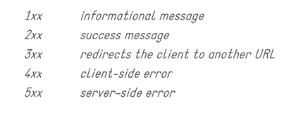
HTTP Status Codes
REST services use HTTP status codes to return information about the response

Slide 44
SOAP vs REST
REST
Exposes RESOURCES which represent DATA
Use HTTP Verbs (GET/POST/PUT/DELETE)
Supports multiple data formats
SOAP
Exposes OPERATIONS which represent LOGIC
Use HTTP POST
Supports only XML (and attachments)
Notes:
The SOAP Header element is an optional child element of the Envelope element. Inside the Header element you can put information that is not part of the body of a SOAP message. Whatever that information could be, is up to you. For instance, it could be information about the maximum time the SOAP request may take to process, or something similar which is not directly related to the message itself.

Slide 45
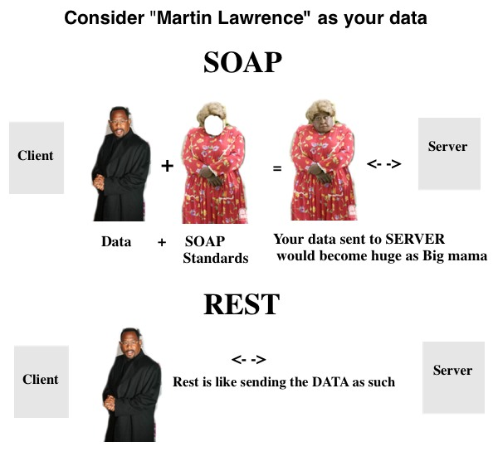
SOAP vs REST

Slide 46
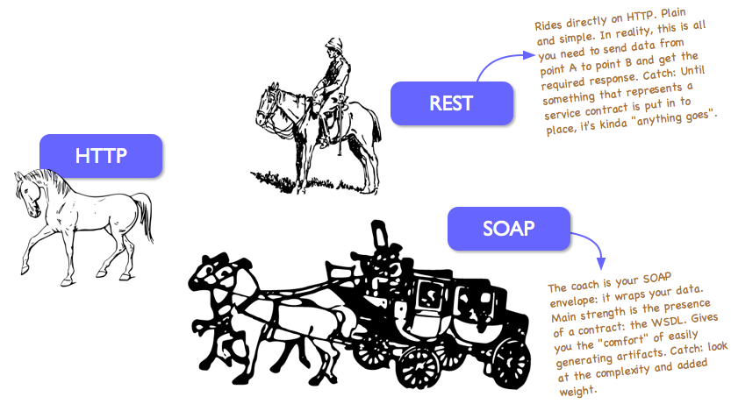
SOAP vs REST

Slide 47

Who Use REST?

Slide 48
Who Prefer SOAP?
Big old companies
Mission critical software systems

Slide 49
Additional Resources
SOAP Specification
http://www.w3.org/TR/2000/NOTE-SOAP-20000508/
REST Articles
http://en.wikipedia.org/wiki/Representational_state_transfer
http://www.ibm.com/developerworks/library/ws-restful/

Slide 50
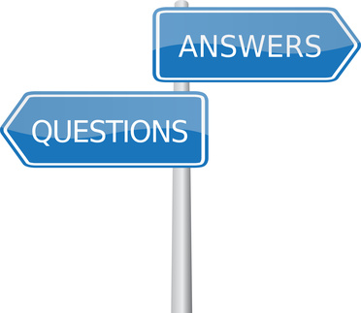
Questions

